Slide 1
Home Page

Slide 2

Home About Pricing Events Donate Contact Sign In
Register

Slide 3
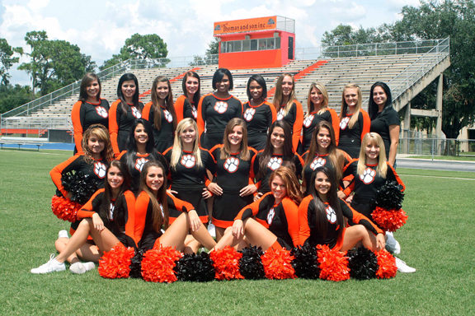
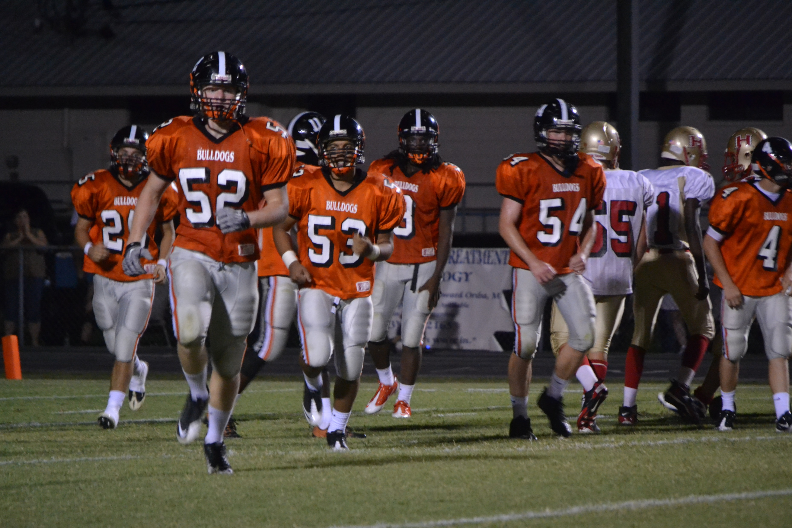
Home About Pricing Events Donate Contact Sign In
Register
Zephyrhills High School Booster
6335 12th Street • Zephyrhills, FL 33542 • Phone: (813) 794-6100
Help Support your team will a small donation

Slide 4

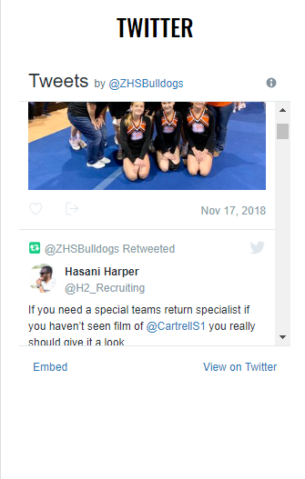
Home About Pricing Events Donate Contact Sign In
Register
Help Support your team will a small donation
Go Bulldogs!
BULLDOG NEWS
Bulldog Expo – Incoming 9th Graders
For incoming 9th Graders. Learn more about what ZHS has to offer! We will be showcasing Career and Technical Education Courses and Clubs. November 26, 2018 @5:30pm in the ZHS Commons. Click here for more...
read more
SAT Test Requirements
Please review information under the Students tab regarding SAT testing dates and requirements.
read more

Slide 5
Home About Pricing Events Donate Contact Sign In
Register
Login
Sign Up
Email:
Email:
Password
Password:
Login
Confirm Password
First Name:
Last Name
Phone Number
Sign Up

Slide 6
Usability

Slide 7

On Click Bring to home page
Home About Pricing Events Donate Contact Sign In
Register
Zephyrhills High School Booster
6335 12th Street • Zephyrhills, FL 33542 • Phone: (813) 794-6100
Help Support your team will a small donation

Slide 8
Active tab is orange
Home About Pricing Events Donate Contact Sign In
Register
Help Support your team will a small donation
Go Bulldogs!
BULLDOG NEWS
Bulldog Expo – Incoming 9th Graders
For incoming 9th Graders. Learn more about what ZHS has to offer! We will be showcasing Career and Technical Education Courses and Clubs. November 26, 2018 @5:30pm in the ZHS Commons. Click here for more...
read more
SAT Test Requirements
Please review information under the Students tab regarding SAT testing dates and requirements.
read more
Live Twitter Feed

Slide 9
Home About Pricing Events Donate Contact Sign In
Register
Login
Sign Up
Email:
123:
Password
*********
Login
*********
Spencer:
Reid
(123) 867-5309
Sign Up

Slide 10
Home About Pricing Events Donate Contact Sign In
Register
Login
Sign Up
Email:
123:
Password
Please type a valid email address!
*********
Login
*********
Spencer:
Reid
(123) 867-5309
Sign Up

Slide 11
Home About Pricing Events Donate Contact Sign In
Register
Login
Sign Up
BobSegar@NightMoves.com
Email:
********
Password:
Email/Password do not match. Please try again.
Confirm Password
First Name:
Login
Last Name
Phone Number
Sign Up

Slide 12
Profile

Slide 13


Home About Pricing Events Donate Contact Welcome Bob!
Profile Children Enroll
Hello Bob!
Your Info:
Name: Bob Segar
Email: BobSegar@NightMoves.com
Phone Number: (123) 867-5309
Alt Number:
Address: 123 Wonder Wall Street, Oasis, WV 50026

Slide 14
Home About Pricing Events Donate Contact Welcome Bob!
Profile Children Enroll
Hello Bob!
Add Children
View Children
Kids Info:
Name: Billy Joel
Student ID: 80105971101117797110
Enrolled Sports: None

Slide 15
Home About Pricing Events Donate Contact Welcome Bob!
Profile Children Enroll
Hello Bob!
Add Children
View Children
Kids Info:
Name: Billy Joel
Student ID: 80105971101117797110
Enrolled Sports: None

